Slide 1
Evaluation Metrics: RMSE and MAPE

Slide 2
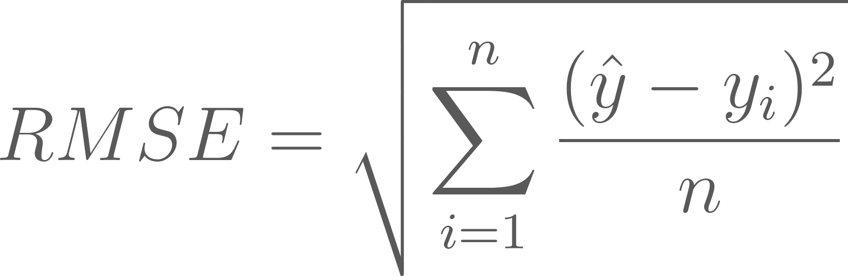
RMSE
The Root-Mean-Square Error, or the Root-Mean-Square Deviation is frequently used to measure the differences between values (sample, or population values) predicted by a model or an estimator and the actual values observed.

Slide 3
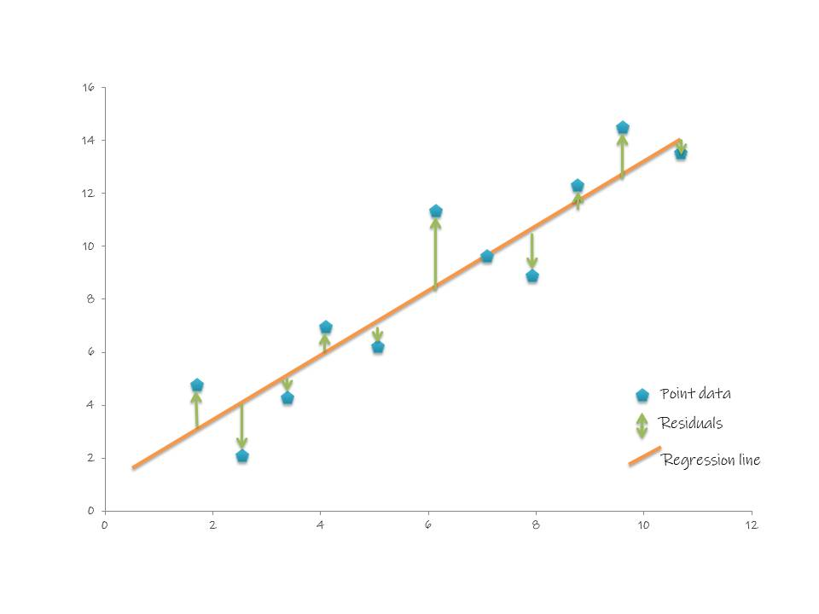
RMSE

Slide 4
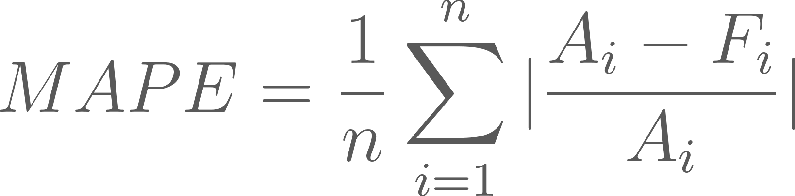
MAPE
The Mean-Absolute-Percentage Error, or The Mean Absolute Percentage Deviation is used to measure accuracy as a percentage where it can be calculated as the average absolute percent error for each time period minus actual values divided by actual values.

Slide 5
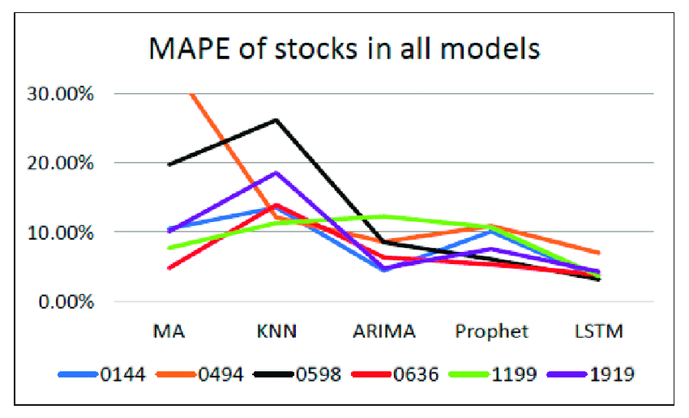
MAPE

